Slide 1
Impact of temperature variations over the Bay of Bengal on the climate of Eastern coast of India
Under the guidance of:
Dr. Saritha Chakrasali
Professor
Department of ISE,
BNM Institute of Technology

Slide 2
Introduction
Artificial intelligence (AI)
creation of human-like intelligence.
learn, reason, plan, perceive, or process natural language.
machine learning.
instructions that allow model to learn from data without step-by-step instructions by the programmer.
Data analytics
qualitative and quantitative techniques and processes
to enhance productivity and business gain.
Data is extracted and categorized to identify and analyze behavioral data and patterns.

Slide 3
Weather - condition of air on earth at a given place and time.
The application of science and technology are to predict the state of the atmosphere in future time.
Extremely important considering its effects on human life and property.
Today, weather forecasts are made by collecting quantitative data about the current state of the atmosphere using scientific understanding of atmospheric processes to project how the atmosphere will evolve.
chaotic nature of the atmosphere implies the need of massive computational power required.

Slide 4
Problem statement
To study the correlation between sea surface temperature to corresponding coastal temperature by implementing supervised machine learning algorithm on the available dataset and to forecast the weather conditions.

Slide 5
Motivation
To be able to recognize pattern between sea surface temperature and land temperature.
Improving weather forecasting process.
Being able to provide warnings in time to reduce the consequences.

Slide 6
System Design
Data Collection
Data Filtering and Cleaning
Feature selection
Regression Model Implementation
Testing
Final trained model
Final application

Slide 7
Dataflow diagram
LEVEL-0
Raw Data
Pre-Processing
Learning
Evaluation
Prediction

Slide 8
LEVEL-1
Raw Data
Pre-Processing
Learning
Evaluation
Prediction
Dimensionality Reduction
Model Selection
Feature Extraction and Scaling
Learnt Model
Feature Selection
Cross Validation
Sampling and
Training Dataset

Slide 9
LEVEL-2
Raw Data
Pre-Processing
Learning
Evaluation
Prediction
Test Data
Performance Metric
Final Model
New Data

Slide 10
Implementation Details
Module-1
Data Collection
Module-2
Data Cleaning and Filtering
Module-3
Feature Extraction
Module-4
Implementing Regression model
Module-5
Final model

Slide 11
Module 1:
Data Collection

Slide 12
Algorithm 1:
step 1: Initialize base url, api key, target date, feature name list.
step 2: open a csv file in write mode
set the fieldnames to feature list values
step 3: for each in range(days)
send a request to the base url defined
convert the api response to json format
write the json data to the opened csv file
increment the target date to next day
end for
step 4: end

Slide 13
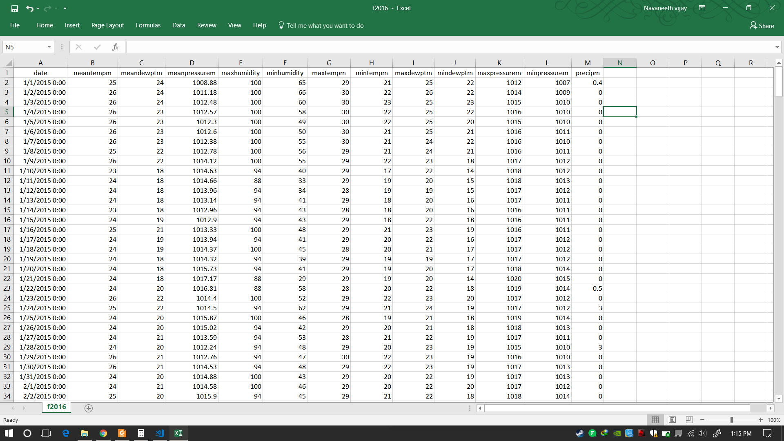

Slide 14
Module 2:
Data filtering and cleaning

Slide 15
Step1: Make a list containing features to remove Step2: Make a list containing features to keep Step3: Convert the selected feature objects into numerical values Set not available values to 'coerce’. Step4: Transpose the DataFrame Set. Step5: Calculate IQR and remove outliers Step6: Data visualization. Step7: End
Algorithm 2:

Slide 16
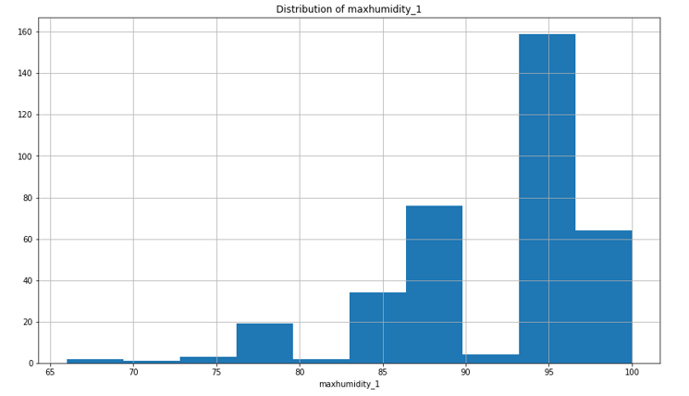

Slide 17
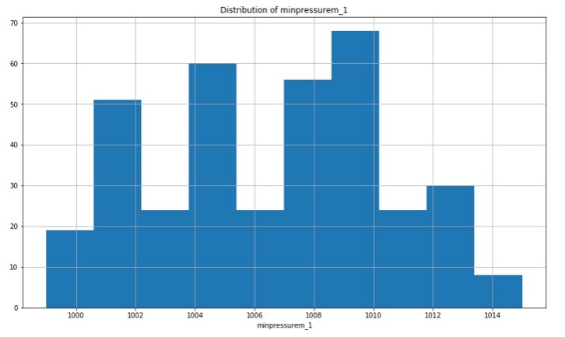

Slide 18
Modules to complete: Module-3, Module-4, Module-5

Slide 19
Thank You!
Submitted by:
Sai Navaneeth V – 1BG14IS041
Satish Kumar M S – 1BG14IS045
Bhavana – 1BG14IS008
H Sudhanva – 1BG14IS017

